Slide 1
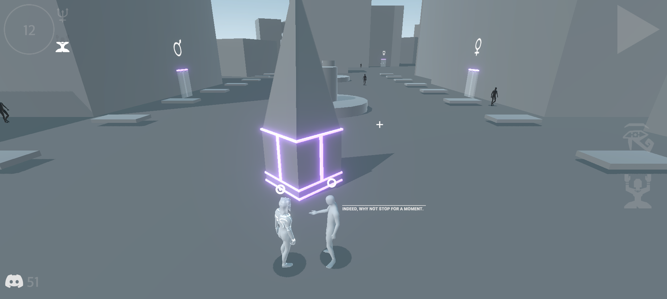


1. You become a member of the server. Make sure there is internet. Enter the game.
See what discord player number you have been assigned (bottom left).

Slide 2
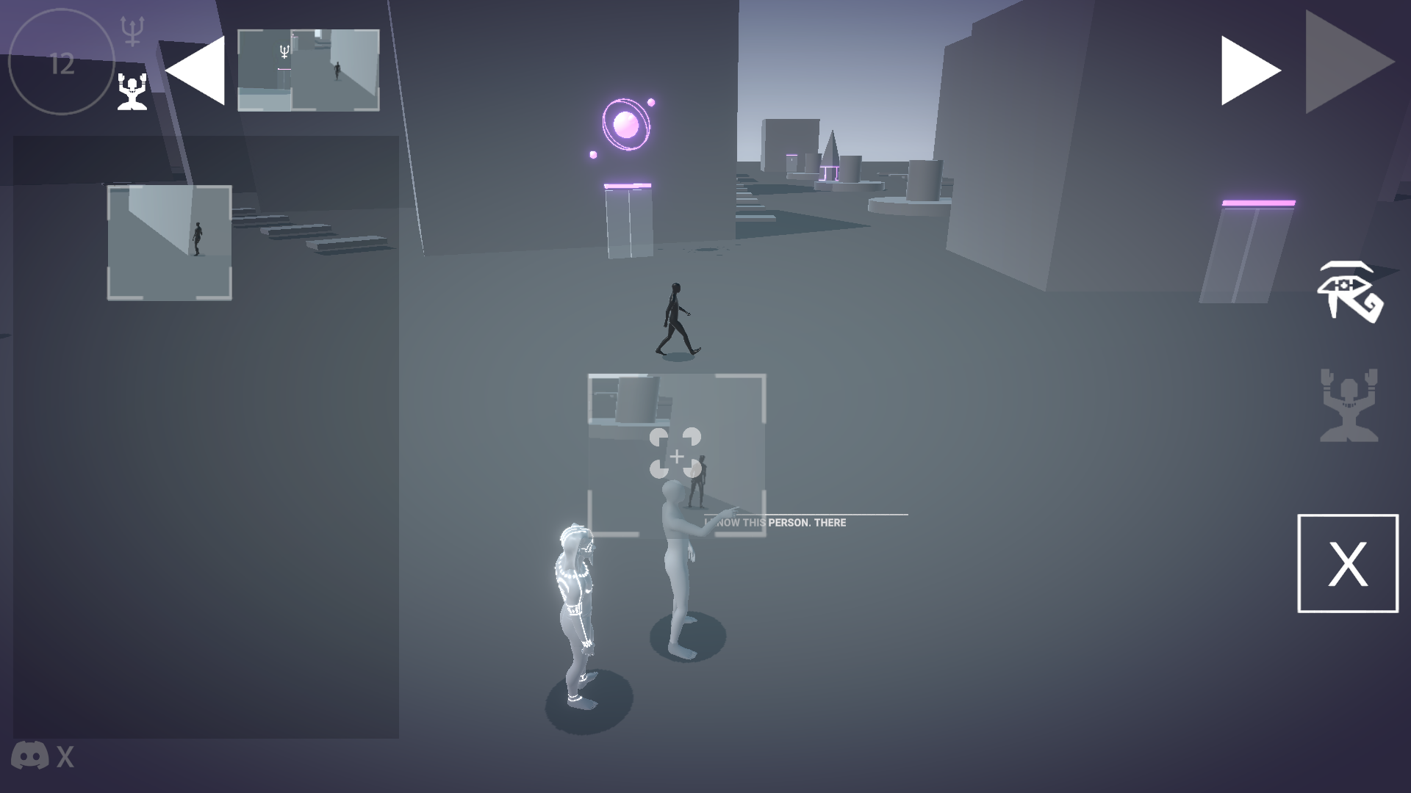
Search among citizens for a player with your friend’s number, and your friend searches for you on his device. How to search? Go to the photos screen (eye icon on the right), write the number of the citizen you are looking for on a piece of paper. Approach any character, start a dialogue, drag the piece of paper onto his active zone above his head. The character points the way.

Slide 3
When you have found a friend's projection in your game, enter into dialogue and drag the point into his circle. Then confirm your decision to fight by entering the proposed circle. Wait for your friend to do the same.

Slide 4
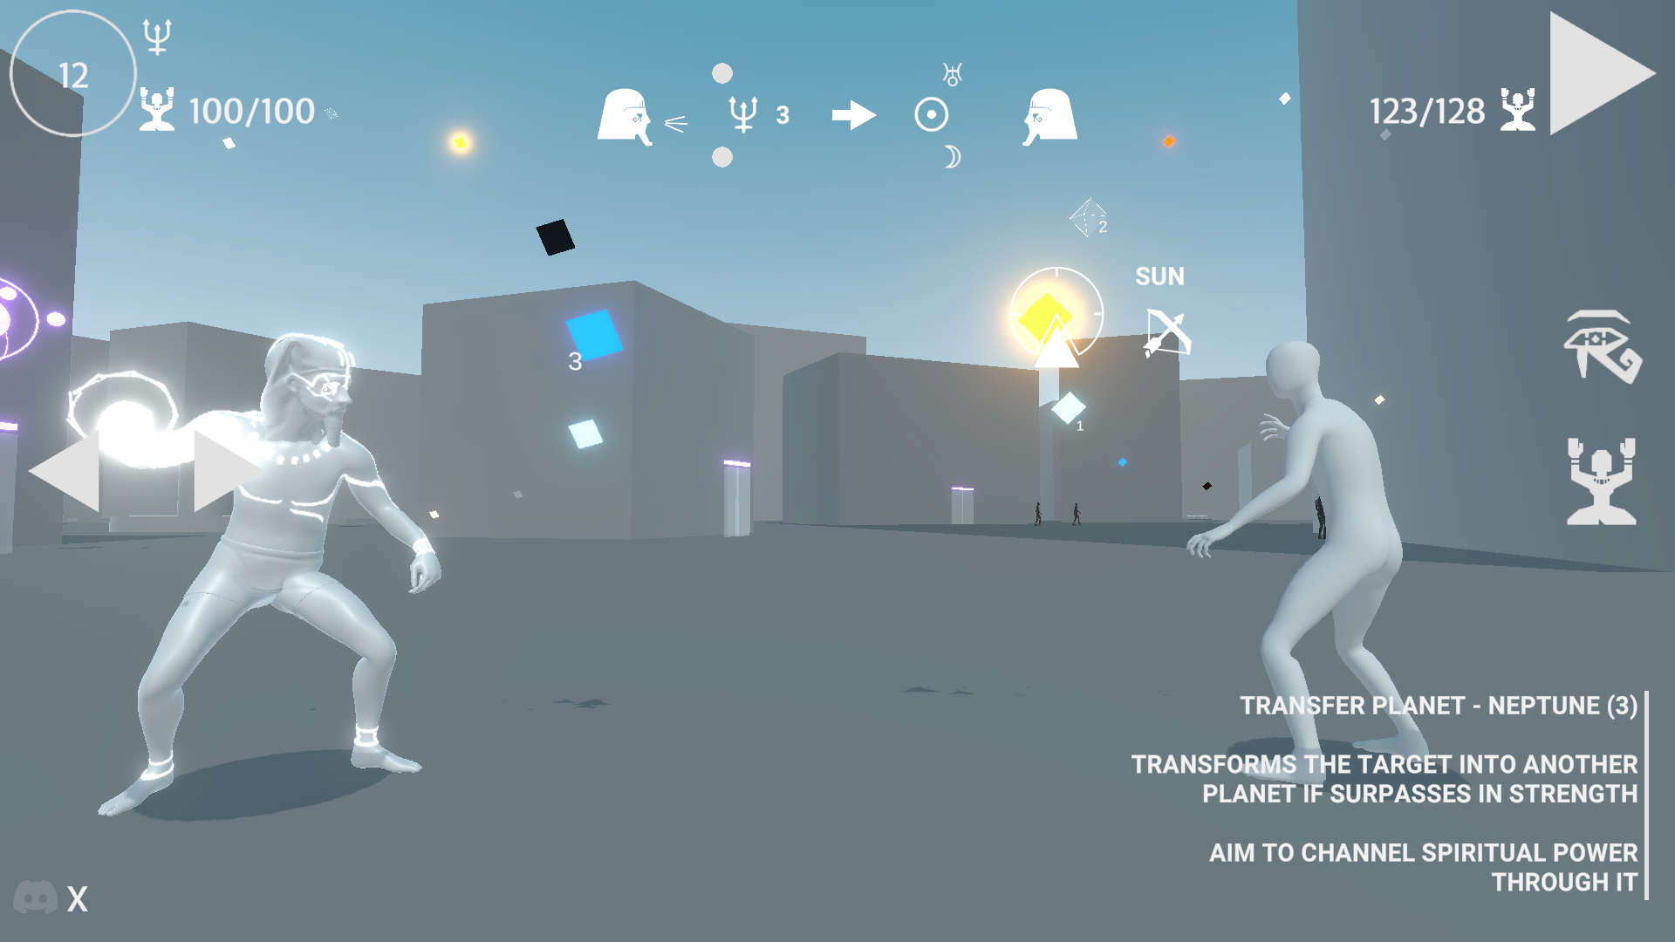
Fight! Try to reduce your opponent's confidence to zero or destroy all of his attacking planets.

Slide 5
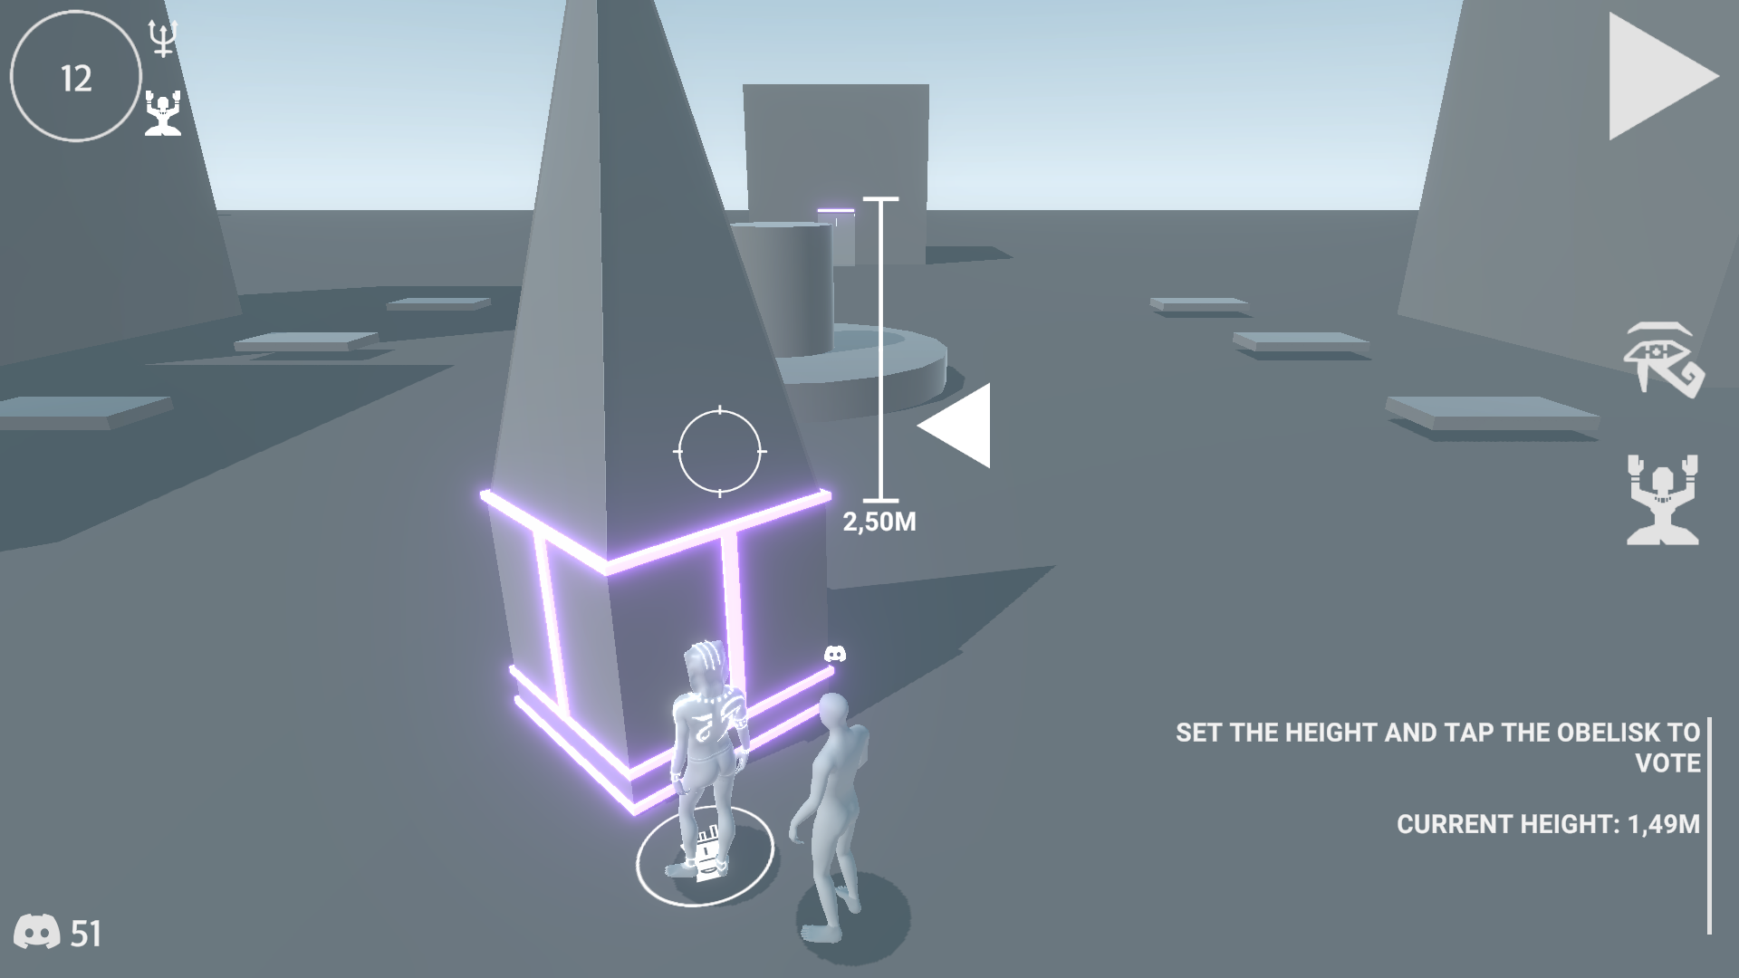
Go to the nearest obelisk to recover. There you can vote for your desired height.

